Slide 1
Project Title: The Cure Team name: The Cure Team leader name: Piyush Vishwakarma
Domain: Health-care Innovations
Problem Statement: If any new virus is spreading then people should know about virus details like living mechanism, reaction to weather conditions, internal structure, effects on humans and other creatures. What is the best way to educate the people regarding the disease symptoms, precautions, remedies to follow, reason for the disease, etc., within no time and should create best awareness. Create a platform for this problem, which can be accessed easily.

Slide 2
Idea / Approach
Our project here provides the user with in depth knowledge of symptoms, diseases along with common and new virus. It also provides home remedies that may help in the treatment. It also provides the information about latest viruses, what diseases they cause and their symptoms.
Here the user can search for their symptom, certain disease or virus and attain information regarding that.

Slide 3
Technology Stack and Use Cases
List all the tools and technologies
used to build and run this application are-
Bootstrap ,Css ,Sublime Text ,Xampp ,PHP ,Xampp ,Apache server , PHPmyadmin ,Bootstrap , Jquery , popper.js , Dreamweaver ,PHP.
Describe your use cases here
The Cure allows the user to search for viruses an diseases ranging from A to Z thus proving to be a wide source of information . The user can easily click on letter tabs provided and gain information about various diseases and virus . Information about the almost all common and dangerous Virus is mentioned in detail to avoids any misconceptions about the same. The web app is made extremely user friendly so that users of all age group can use it . The web app on the front end functions on Apache server while the back end functions on PHPmyadmin. The web app keeps a track of all new viruses specially COVID-19 and has a dedicated page for it .

Slide 4
Block Diagram / Architectural Diagram
MY SQL DATABASE
PHP SERVER
Client side application (front end)

Slide 5
Dependencies
The list of all the dependencies used in software are -
Xampp
Apache server
PHPmyadmin
Bootstrap
Jquery
popper.js
Dreamweaver
PHP

Slide 6
Social Impact Analysis with COVID19
During this world wide pandemic this project will help provide information about various diseases and viruses so that people and stay well educated thus this would help reduce situations where people panic due to lack of knowledge of various symptoms.

Slide 7
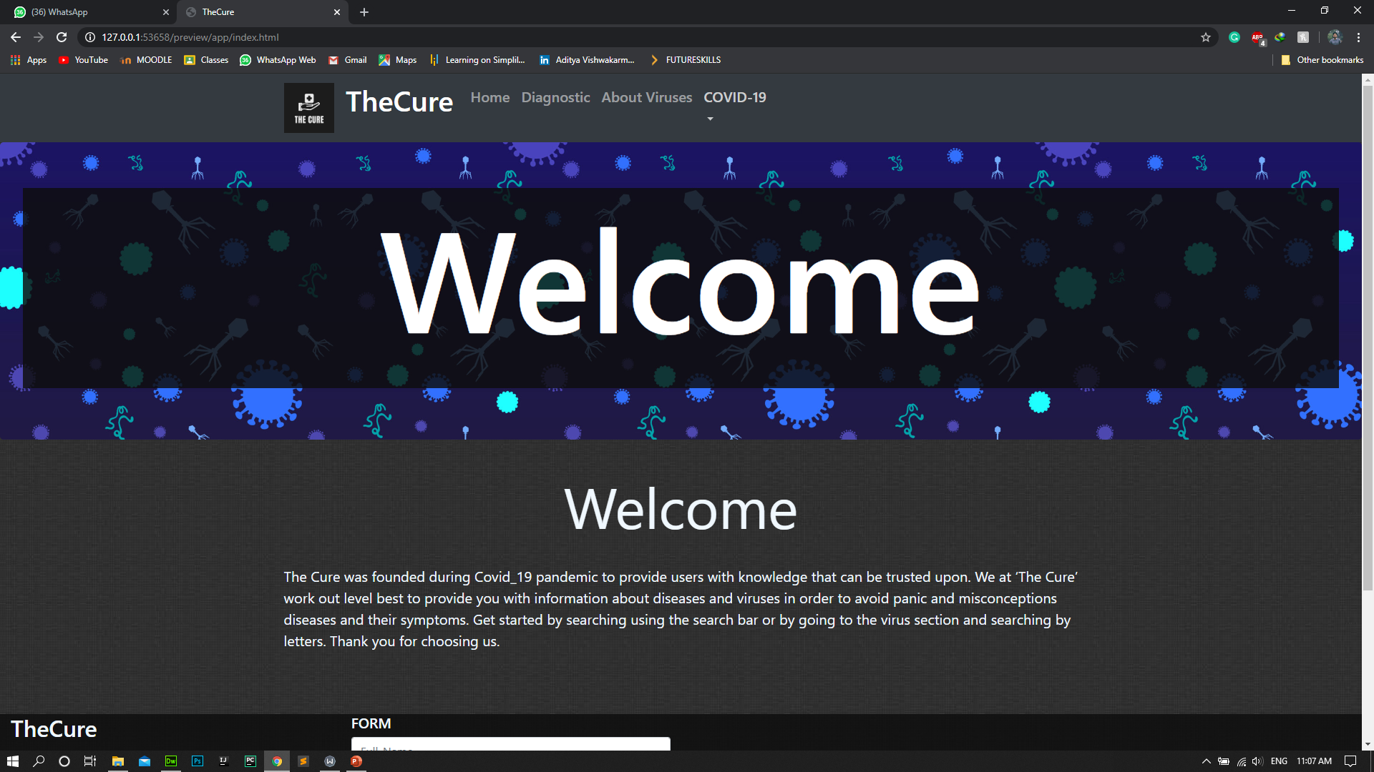
Implementation

Slide 8
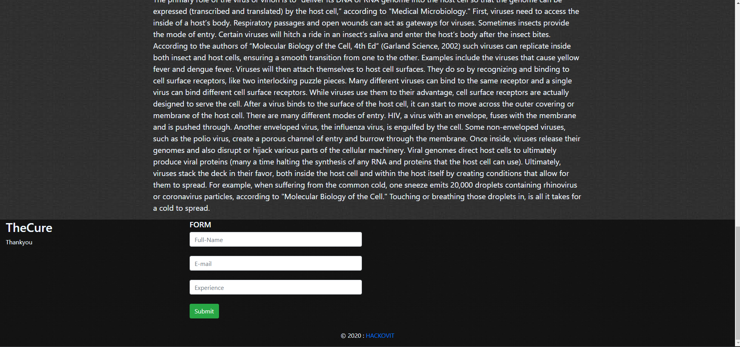
Implementation

Slide 9
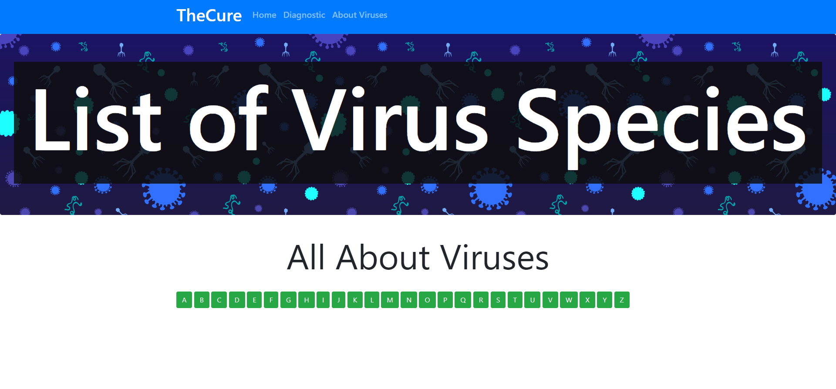
Implementation
Add the snapshots of the project here.

Slide 10
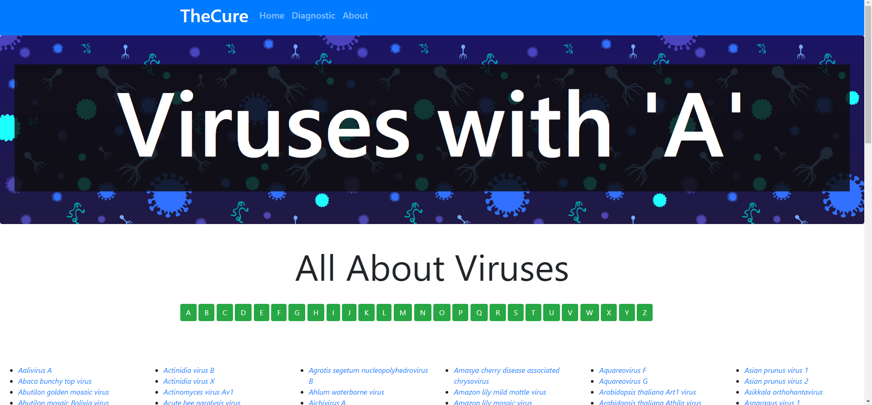
Implementation
Add the snapshots of the project here.

Slide 11
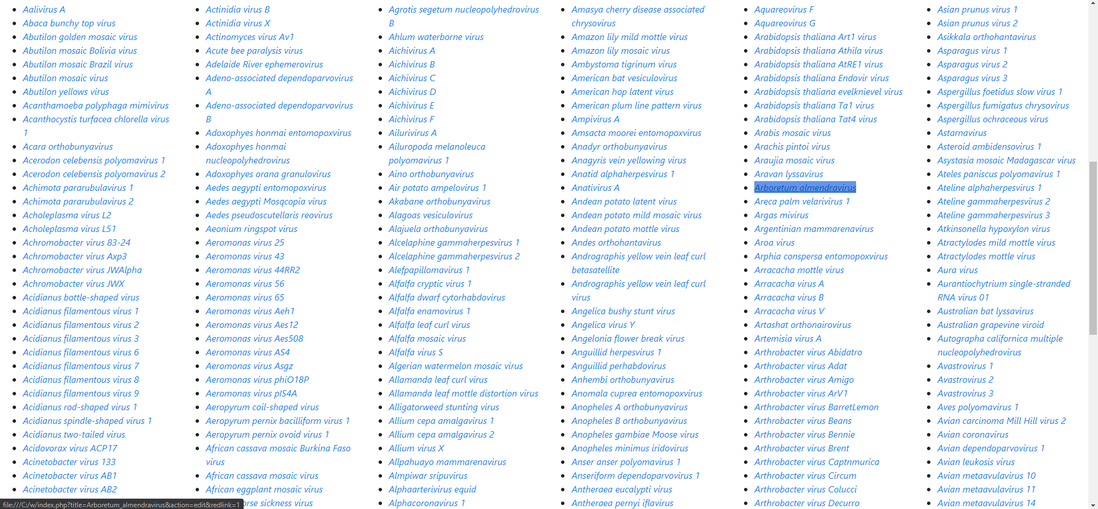
Implementation
Add the snapshots of the project here.

Slide 12
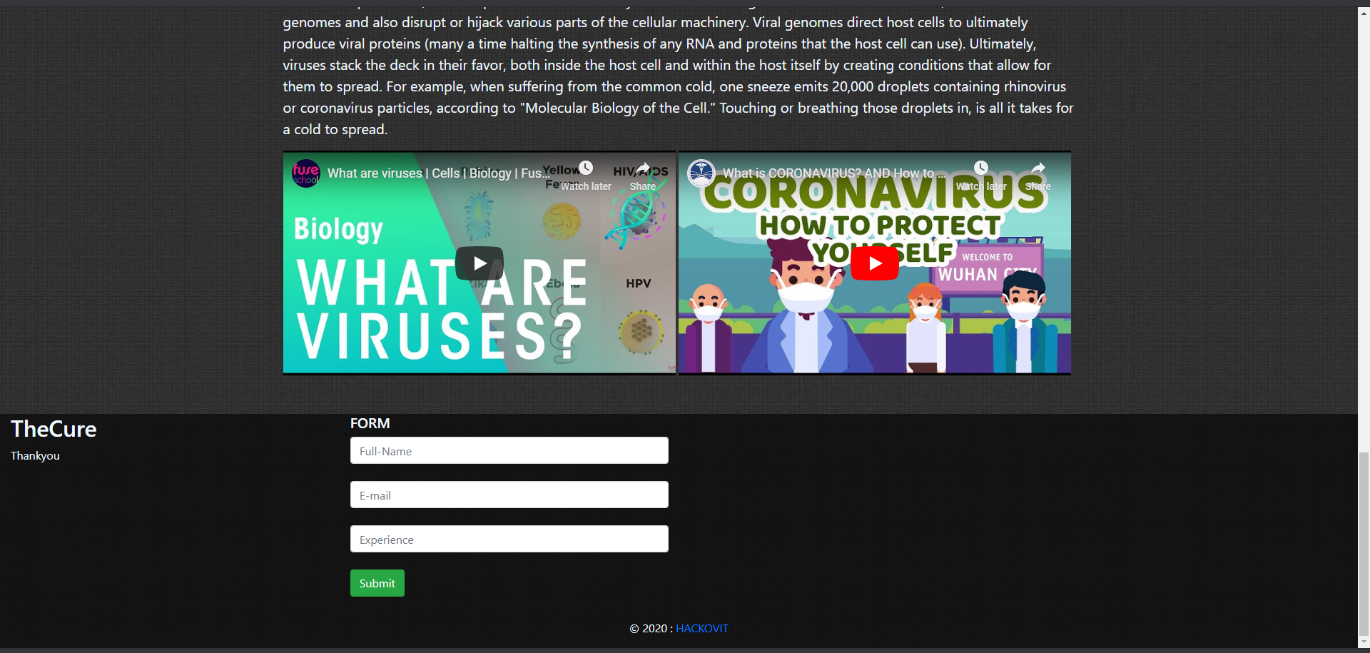
Implementation
Add the snapshots of the project here.

Slide 13
Link to the project
GitHub link:
Google Drive link:

